Slide 1
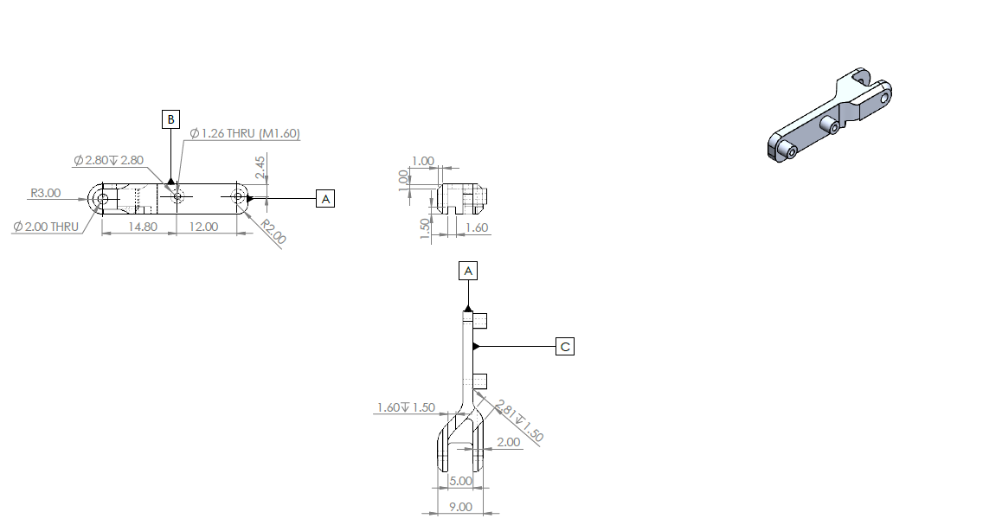
ShiaanX CNC Job Card – Job ID: SX-2025-0041 | Part: 3MCYH2_2 (AL-6061 T6)
Job Overview
Job ID | Part Name | Material | Batch Size | Drawing No.
SX_2526_0041 | 3MCYH2_2 | AL 6061-T6 | 10 | 3MCYH2

Slide 2
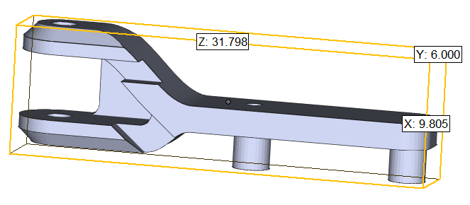
ShiaanX CNC Job Card – Job ID: SX-2025-0041 | Part: 3MCYH2 (AL-6061 T6)
Raw Material Procurement
Material Specification: AL 6061 T6
Raw Material Shape: Block
Raw Material Size for 1 part: 15*10*35mm
Timeline: Start: 12-09-2025 End: 13-09-2025
Estimated: 2 days
Quality Checkpoint
Checkpoint | Parameter | Tolerance | Frequency | Inspector
QC1 | Raw Material MTC | As per specs | 1 time per batch

Slide 3
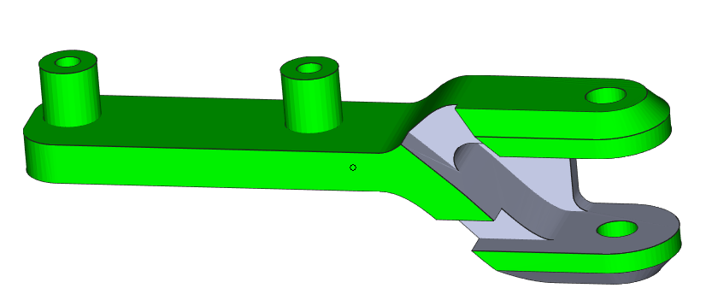
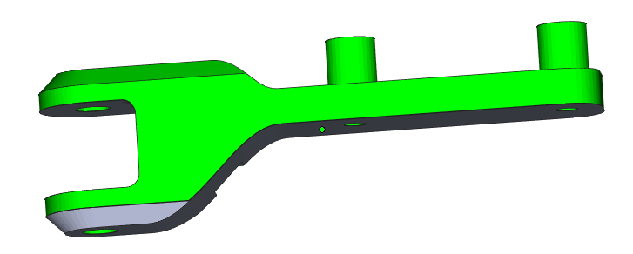
ShiaanX CNC Job Card – Job ID: SX-2025-0041 | Part: 3MCYH2 (AL-6061 T6)
VMC Setup-1 (Milling and Drilling)
Machine: VMC 3 Axis
Tools: - Endmill cutter dia 2, flat drill 1.5 & dia 2, Ball nose dia 2
Tolerance: ±0.05mm
Cutting Parameters: RPM: 1200, Feed: 0.15 mm/rev, DOC: 1.5 mm Timeline: Start: 19-09-2025 End: 19-09-2025
Est:
Green Area- Machined as per 2d drawing
Quality Checkpoint
Checkpoint | Parameter | Tolerance | Frequency | Inspector
QC1 | Dia 2 | +0.05mm | 100%
QC2 | Dia 2.8 | ± 0.05 mm | 100%
QC3 | 26 mm | ± 0.05 mm | 100%
QC3 | 6mm | ± 0.05 mm | 100%

Slide 4
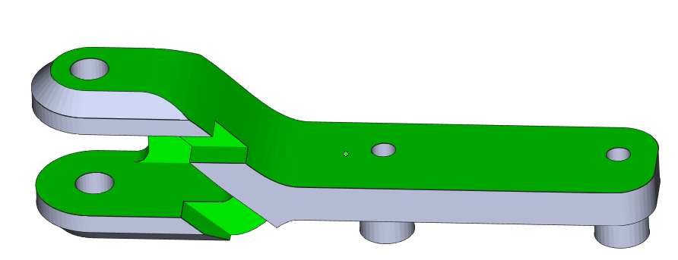
ShiaanX CNC Job Card – Job ID: SX-2025-0041 | Part: 3MCYH2 (AL-6061 T6)
VMC Setup-2 (Milling)
Machine: VMC 3 Axis
Tools: - Endmill cutter dia 2, dia 1.5mm
Tolerance: ±0.05mm
Cutting Parameters: RPM: 1200, Feed: 0.15 mm/rev, DOC: 1.5 mm Timeline: Start: 20-09-2025 End: 20-09-2025
Est:
Green Area- Machined as per 2d drawing
Quality Checkpoint
Checkpoint | Parameter | Tolerance | Frequency | Inspector
QC1 | 9.8 mm | +0.05mm | 100%
QC2 | 5 mm | ± 0.05 mm | 100%
QC3 | 2.81 mm | ± 0.05 mm | 100%
QC3 | 5.63 mm | ± 0.05 mm | 100%

Slide 5
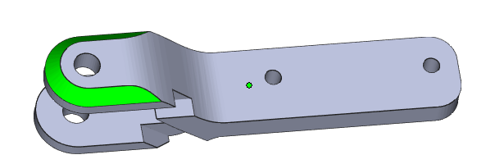
ShiaanX CNC Job Card – Job ID: SX-2025-0041 | Part: 3MCYH2 (AL-6061 T6)
VMC Setup-3 (Milling)
Machine: VMC 3 Axis
Tools: - Ballnose 2mm
Tolerance: ±0.05mm
Cutting Parameters: RPM: 1200, Feed: 0.15 mm/rev, DOC: 1.5 mm Timeline: Start: 20-09-2025 End: 20-09-2025
Est:
Green Area- Machined as per 2d drawing
Quality Checkpoint
Checkpoint | Parameter | Tolerance | Frequency | Inspector
QC1 | 9.8 mm | +0.05mm | 100%
QC2 | 5 mm | ± 0.05 mm | 100%
QC3 | 2.81 mm | ± 0.05 mm | 100%
QC3 | 5.63 mm | ± 0.05 mm | 100%

Slide 6
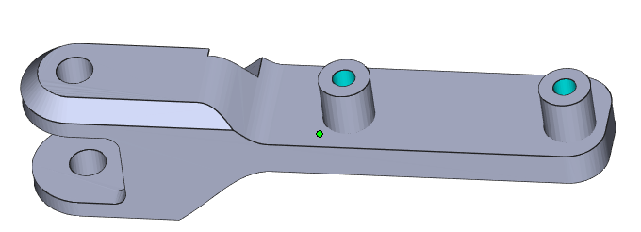
ShiaanX CNC Job Card – Job ID: SX-2025-0041 | Part: 3MCYH2 (AL-6061 T6)
Setup-3 (Manual Tapping M1.6x0.4mm)
Machine: Manual Tapping
Tools: - Tapping set of M1.6
Tolerance: NA
Tapping Parameters: M1.6x 0.4mm
Timeline: Start: 21-09-2025 End: 21-09-2025
Est:
Blue Area- Tapping as per 2d drawing
Quality Checkpoint
Checkpoint | Parameter | Tolerance | Frequency | Inspector
QC1 | M1.6 x0.4MM | NA | 100%

Slide 7
ShiaanX CNC Job Card – Job ID: SX-2025-0041 | Part: 3MCYH2 (AL-6061 T6)
Timeline & Sign-off
Start Date | Estimated Completion | Delivery Due Date
19-09-2025 | 21-09-2025 | 22-09-2025
Vendor Signature | Date | ShiaanX Approval | Date

